Slide 1
PETER MICHAEL BLAU
DR. SYED MEHDI ABBAS ZAIDI
Department of Sociology
Shia PG College,Lucknow

Slide 3
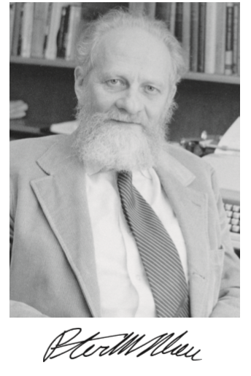
Peter Michael Blau (February 7, 1918 – March 12, 2002)
was an American sociologist and theorist. Born in Vienna, Austria, he immigrated to the United States in 1939. He completed his PhD doctoral thesis with Robert K. Merton at Columbia University in 1952, laying an early theory for the dynamics of bureaucracy
One of Blau's most important contributions to social theory is his work regarding exchange theory, which explains how small-scale social exchange directly relates to social structures at a societal level.
His sociological specialty was in organizational and social structures. He formulated theories relating to many aspects of social phenomena, including upward mobility, occupational opportunity, and heterogeneity.

Slide 4
Major Works
Dynamics of Bureaucracy (1955)
Bureaucracy in Modern Society (1956)
A Theory of Social Integration, "The American Journal of Sociology", Vol. LXV, No. 6, p. 545 (1960)
A Theory of Social Integration (1960)
Formal Organizations: A Comparative Approach, with Richard Scott (1962)
Exchange and Power in Social Life (1964)
The Flow of Occupational Supply and Recruitment "American Sociology Review" (1965)
The American Occupational Structure (1967)
A Formal Theory of Differentiation in Organizations (1970)
The Organization of Academic Work (1973)
Presidential Address: Parameters of Social Structure "American Sociology Review" (1974)
On the Nature of Organizations (1974)

Slide 5
Background
Social exchange theory was introduced in 1958 by the sociologist George Homans with the publication of his work "Social Behavior as Exchange“
After Homans founded the theory, other theorists continued to write about it, particularly Peter M. Blau and Richard M. Emerson, who in addition to Homans are generally thought of as the major developers of the exchange perspective within sociology
Peter Blau - social exchange theory more towards the economic and utilitarian perspective, whereas Homans focused on reinforcement principles which presuppose individuals base their next social move on past experiences.
Blau felt that if individuals focused too much on the psychological concepts within the theory, they would refrain from learning the developing aspects of social exchange

Slide 6
Exchange Theory
Peter Blau expanded Homan’s theory by extending it to more complex issues like, social structures, organisation, and bureaucracy.
Social exchange theory is a social-psychological and sociological perspective that explains social change and stability as a process of negotiated exchanges between parties
Social exchange theory posits that human relationships are formed by the use of a subjective cost-benefit analysis and the comparison of alternatives. The theory has roots in economics, psychology and sociology

Slide 8
Basic Exchange Principles
Blau employs the basic concepts of all exchange theories- Reward, Cost and Profit
Cost and rewards
social exchange models assume that rewards and costs drive relationship decisions
Both parties in a social exchange take responsibility for one another and depend on each other. The elements of relational life include:
Costs are the elements of relational life that have negative value to a person, such as the effort put into a relationship and the negatives of a partner- (Costs can be time, money, effort etc.)
Rewards are the elements of a relationship that have positive value. (Rewards can be sense of acceptance, support, and companionship etc.)
Worth = Rewards – Costs
If worth is a positive number, it is a positive relationship, a negative number indicates a negative relationship

Slide 9
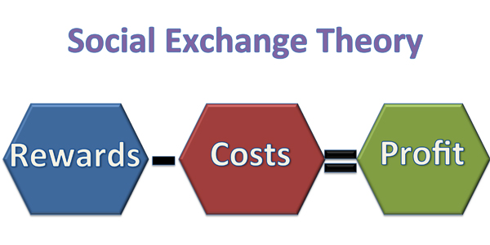
Social Exchange
Positive relationships are expected to endure, whereas negative relationships will probably terminate. Mutual relationship satisfaction ensures relationship stability
Outcome = Rewards – Cost

Slide 10
Blau’s Implict Exchange Principles
1. The rationality Principles
The more profit people expect from one another in emitting a particular activity, the more likely they are to emit that activity
2 . The reciprocity Principles
A. The more people have exchanged rewards with one another, the more likely are reciprocal obligations to emerge and guide subsequent exchanges among these persons.
B. The more the reciprocal, eligation of an exchange relationship are violated, the more are deprived parties disposed to sanction negatively those violating the norm of reciprocity.
3. The Justice Principles
A. The more exchange relations have been established, the more likely they are to be governed by norms of ‘’fair exchange.”
B. The less norms of fairness are realized in an exchange, the more are deprived parties disposed to sanction negatively those violating the norms

Slide 11
Blau’s Implict Exchange Principles
4.The Marginal Utility Principles
The more expected rewards have been forthcoming from the emission of a particular activity, the less valuable is the activity, and the less likely is its emission
5. The Imbalance principle
The more stabilized and balanced are some exchange relations among social units, the more likely are other exchange relations to become imbalanced and unstable

Slide 13
Refrences
Blau, Peter . "Exchange and Power in Social Life". 1st edition. 1. New York: John Wiley and Sons, Inc, 1964. Print
Ritzer, George. “Sociological Theory”.5th edition, McGraw Hill Education ,2011.
Turner, Jonathan H. “The Structure of Sociological Theory”.4th edition, The Dorsey Press,1987. Rawat Publication ,reprinted,2015.

Slide 14
Thank You

